Slide 1

E-learning platform Marketing strategy

Slide 2

Brief About Us
high-quality, accessible online education for healthcare professionals in Egypt and beyond, empowering people with the knowledge and skills to excel in their careers and contribute to the advancement of healthcare.

Slide 3
Business Model Canvas
Key partners
Key Activities
Value Proposition
Customer Relationships
Customer segmentation
hospital
healthcare centers
technology companies
Course development
Marketing and sales
Customer support
Technology maintenance
Professional Medical era
Professional Growth.
Credible source of healthcare management training.
Flexible learning.
Expert instructors.
Offers
Suggest relevant courses based on learners' interests and progress.
Offer dedicated customer support
loyalty program.
Healthcare professionals: Doctors, nurses, medical students
Healthcare organizations: Hospitals, clinics,
18 and above
egypt and the middle east
Cost Structure
Course development costs
Technology costs
Instructor fees
Marketing and sales expenses
Customer support costs
Course content
Technology infrastructure
Expert instructors
Marketing and sales team
websites
Key Resources
competitors
Channels
edX
udemy
khan academy
MedCram
meduo
Osmosis
AMBOSS
website or app for course delivery.
Social media
Email marketing
Partnerships with healthcare organizations and to reach their members.
Revenue Streams
Course fees.
Certification fees.
Premium content.

Slide 4
Situation analysis

Slide 5
My competitors analysis:
in the e-learning platform for medical courses :
edX
Udemy
Khan Academy
MedCram
$50 to $300 or more per course, depending on the course and institution.
from $20 to $200 or more, depending on factors such as the course's depth, quality, and instructor reputation.
does not charge for access to its medical-related content.
Subscription prices vary based on the duration and level of access, but they can range from $10 to $40 per month.
Osmosis
Lecturio
AMBOSS
Memorang
$15 to $50 per month, depending on the subscription plan.
from $30 to $50 per month, depending on the subscription plan.
around $50 to $300 or more per year, depending on the subscription plan
from $10 to $30 per month, depending on the subscription plan.

Slide 6
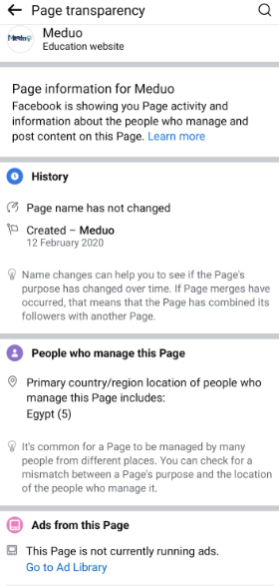
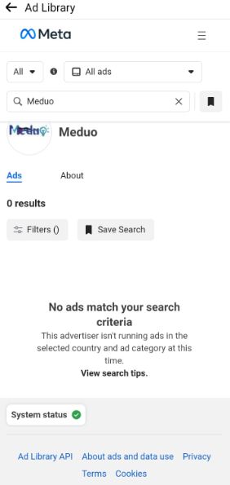
Meduo competitor analysis sample
Meduo hashtags:
#meduo
#Learntmedical
#meduohits
Platforms:
facebook 5-6 photo post per month
Instagram Photo and Reels
youtube sample record from session range of 3-5 minutes
Linked In Not active

Slide 7
SWOT Analysis
Strength
weakness
Threats
Opportunities
Trusted organization.
Offering courses in Arabic and English for a wider audience
Certified instructors.
Cost effective.
highest quality of content
Accessibility
Interactive learning tools
Flexibility
offering networking opportunities
Technical problems.
Unfamiliarity of technology form instructors.
Practical rounds with high no of trainees.
Lack of face-to-face interaction.
The online education market is competitive
Fragmented market.
Motivation and discipline.
Marketing challenges (not all customers could be reached thru same channel.
Rapidly changing laws and regulations.
Technical challenges.
Economic fluctuations in Egypt
Wide spread of e-learning
Healthcare accreditation of GAHAR.
Egyptian Health council regulations.

Slide 8
Objective
Introduce product and Improve awareness 10% about the quality of e-learning materials.(first 4 month )
to be accredited by the government by Q1 2025.
Credible source of healthcare education.
Get 10,000 Enrollment on website by December,2025.
Get 1000 subscription December,2025.
get 1000 follower on tiktok .
Be the market leader in Healthcare education.
Build communication lines between 600 trainee and relevant hiring organization.

Slide 9
Strategy

Slide 10

Buyer persona
Age
23-55 years
Income
Educational level
Medium
Aspirations
High (medical degree)
Professional growth
Location
Urban area with a medium-sized hospital (Cairo& Governorate residents)
Dr Sara Ahmed
30 years old
Profession
Medical graduate specializing in internal medicine
Employed full-time at a local hospital

Slide 11
Buyer persona
Behavior
Goals and Challenges
Values convenience and flexibility in learning.
Prefers practical and applicable knowledge.
Wants to stay updated with the latest medical advancements.
Desires to advance her career
Motivations
Pain Points
Career advancement
Career Shift in another specialization.
Improved patient care.
professional growth.
Earning potential.
Limited time for continuing education.
High cost of traditional medical education programs.
Difficulty finding relevant and up-to-date courses. Lack of hands-on practice opportunities.
Dr Sara Ahmed
30 years old

Slide 12

Unique Selling Proposition
Unique Selling Proposition (USP):
Our online e-learning platform offers a comprehensive and engaging learning experience tailored to Egyptian healthcare professionals, featuring expert-led courses, interactive learning tools, flexible learning options, and strong community support, all designed to advance your career and stay up-to-date with the latest healthcare trends.

Slide 13
Tactics

Slide 14
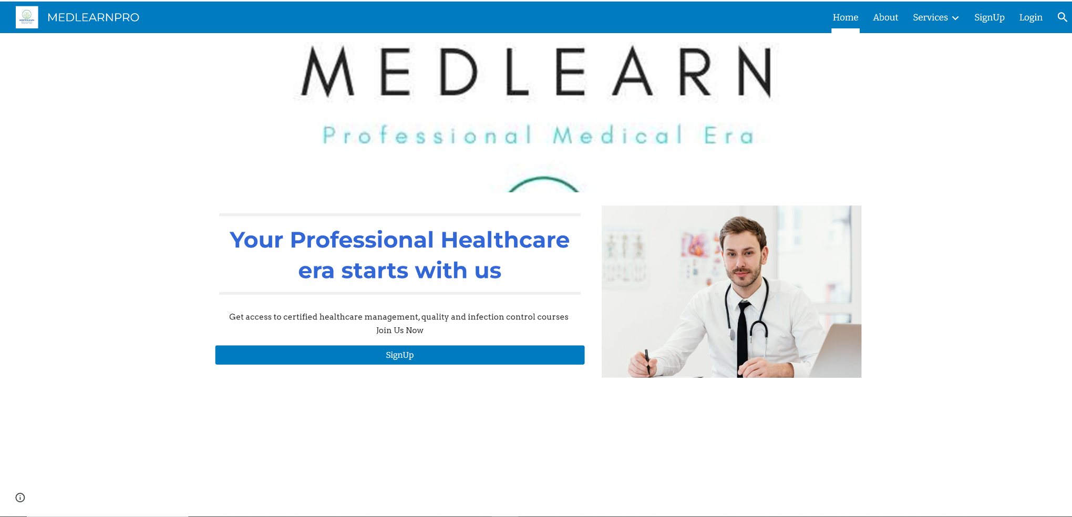
1.Product
7Ps
Online Courses for medical professions on E-platform.
Accessible on desktop browsers, IOS, Android applications. for more accessibility.
3 different bundles.
25 hours / course on 6 weeks.
5 hours interactive session.
5 hours of practical session(optional)

Slide 15
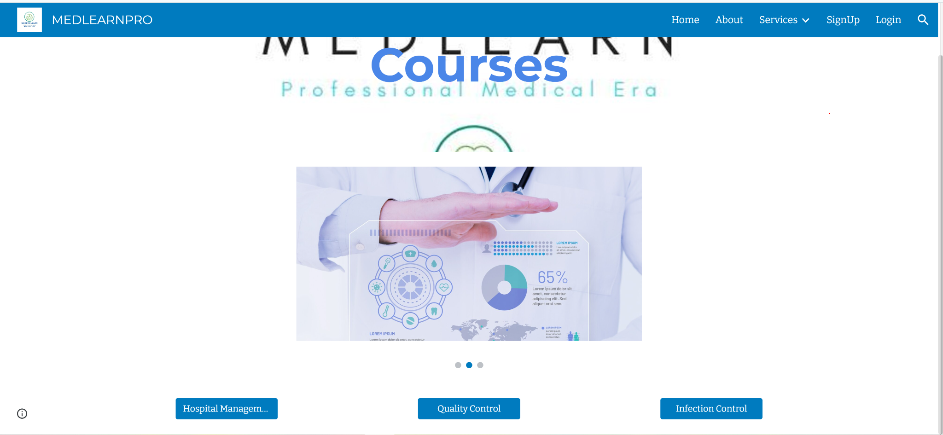
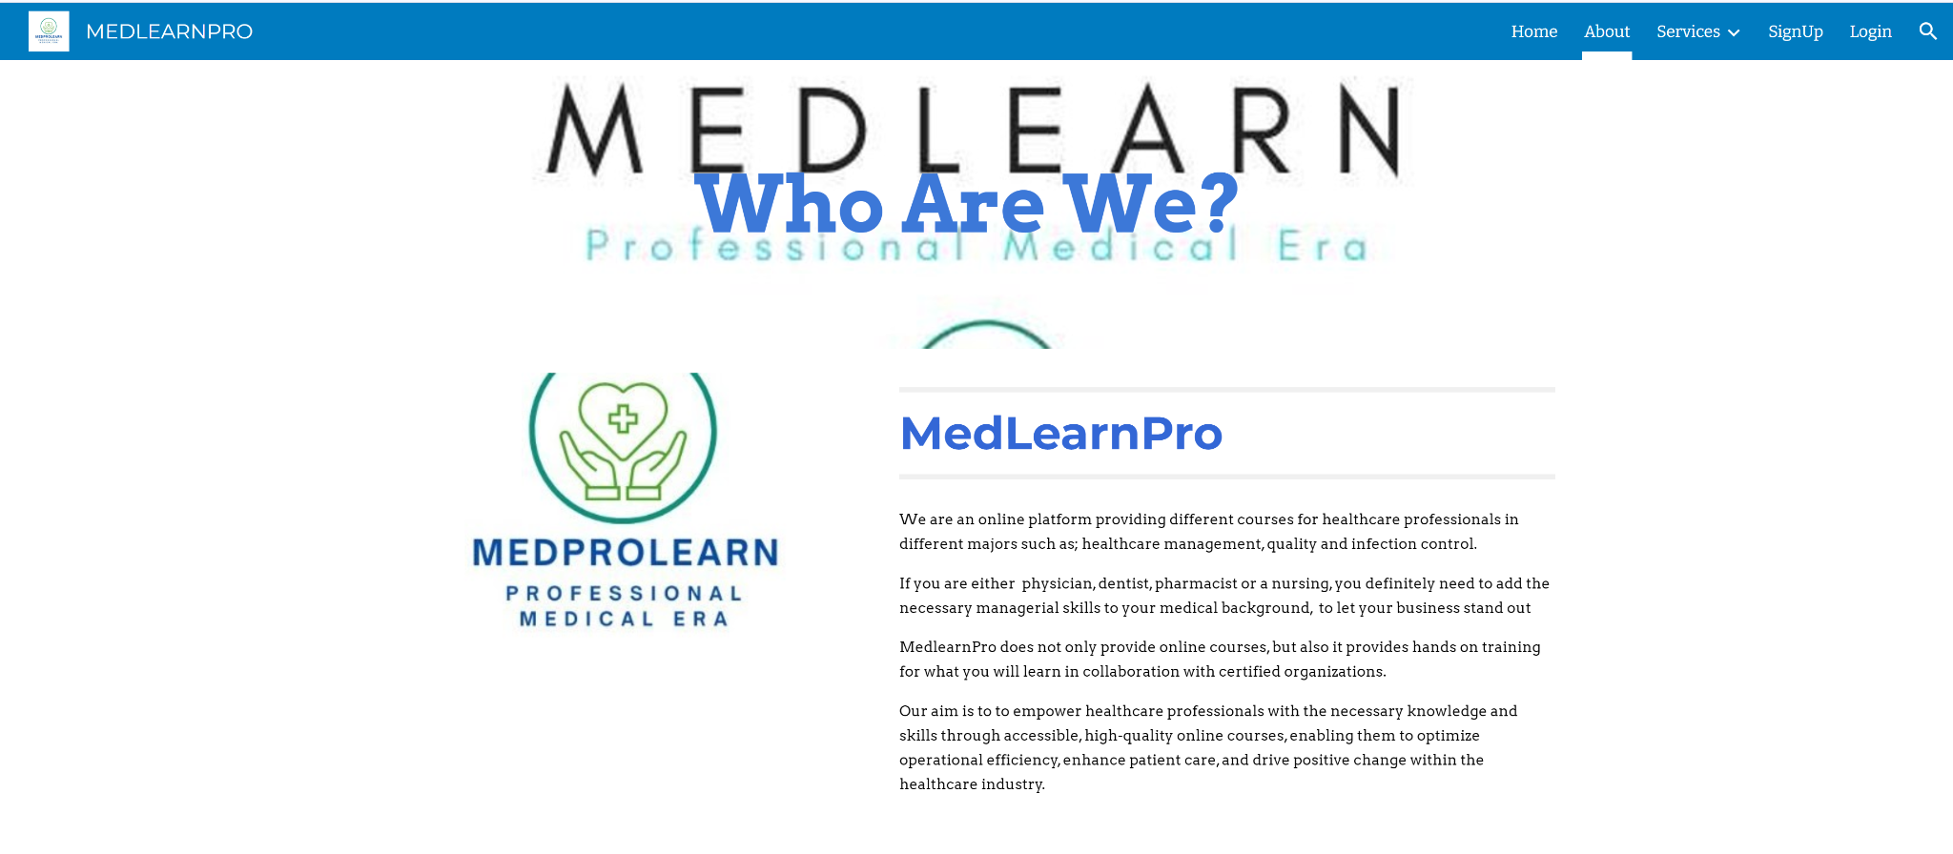
https://sites.google.com/view/medlearnpro/services/courses?authuser=1

Slide 16
2.Price
1-Target Audience Affordability:
Our audience medical students, healthcare professionals, and individuals seeking continuing medical education. The Average income levels $100-$200.
2-Pricing Models: one-time course purchases.
My average price will range from $30- $ 150.

Slide 17
3.Place
Head-Office:
Located at Downtown:
Available rooms specialized for recording the sessions. With technical support.
3 Lecture rooms with capacity of 50 persons for physical attendance days.
Website and E-commerce:
Website under the supervision of governmental agency.
Uploading covered materials, schedules, required assignment, educational videos. (each subject holds its own material).
Publishing all the updates through notifications pop ups on website.

Slide 18
4.Promotion
M-Commerce: Mobile applications divided into subjects sectors with uploaded covered material same as website, linked together with same username and password to login. (allowing the audience to choose easiest way to use e learning program.
Ads
Offers
Special prices for beginner levels
( 20% off) Special offers on multiple courses and course bundles
Offers for certain organizations in exchange for data
Digital ads at hospitals especially those providing training sessions, medical centers and medical syndicate
sponsored ads on Facebook, Instagram YouTube , X and TikTok.
Banners at medical conferences, and university hospitals used for postgraduate trainings.
Direct Marketing
Interactive marketing
Awareness sessions on quality, infection control, and hospital management field in hospitals among different governorates.
Active content on Facebook and Instagram.

Slide 19
Social Media Marketing
Egypt Region acc. to geography, demography
Middle East countries:
1) Facebook page
1) YouTube
4) LinkedIn
Hub Website
2) YouTube
4)Facebook
Hub Website
2) X and Instagram
3) Instagram
3) TikTok sponsored ad

Slide 20
Hashtags used with different platforms:
#Online_courses
#Online_platform
#Healthcare_training
#Professional_development
#hospital
#hospital_management
#healthcare_quality
#healthcare_management
#healthcare_leadership
#healthcare_excellence
#career_growth
#freecourses
#continous_learning

Slide 21
5.People
Instructors: qualified and experienced instructors and they provide active learning for the audience.
Customer support: The quality of customer service provided to learners is responsiveness and helpfulness.
6.Process:
The ease of creating an account and enrolling in courses.
Sequence of lessons, assessments, and assignments.
The availability of technical support for learners who encounter problems with the platform.

Slide 22
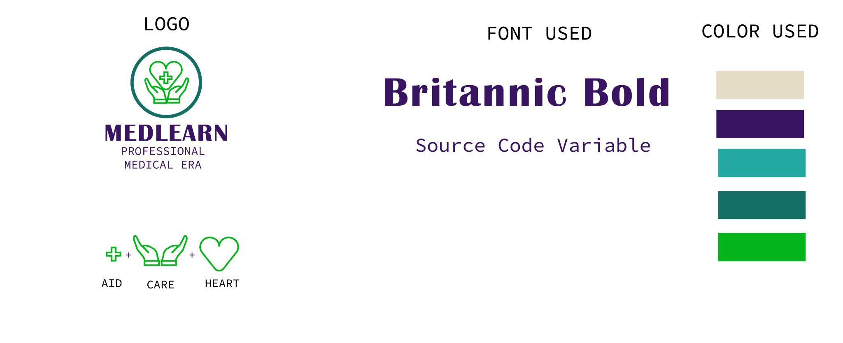
7.Physical Evidence:
Platform design: The visual appearance using the blue and green colors ,HD images and the logo
Course materials: Textbooks, handouts, and HD videos.
Certifications: Physical or digital certificates awarded to learners upon completion of the courses.
Green:
Sustainability, renewal and balance Blue: Trust and professionalism

Slide 23
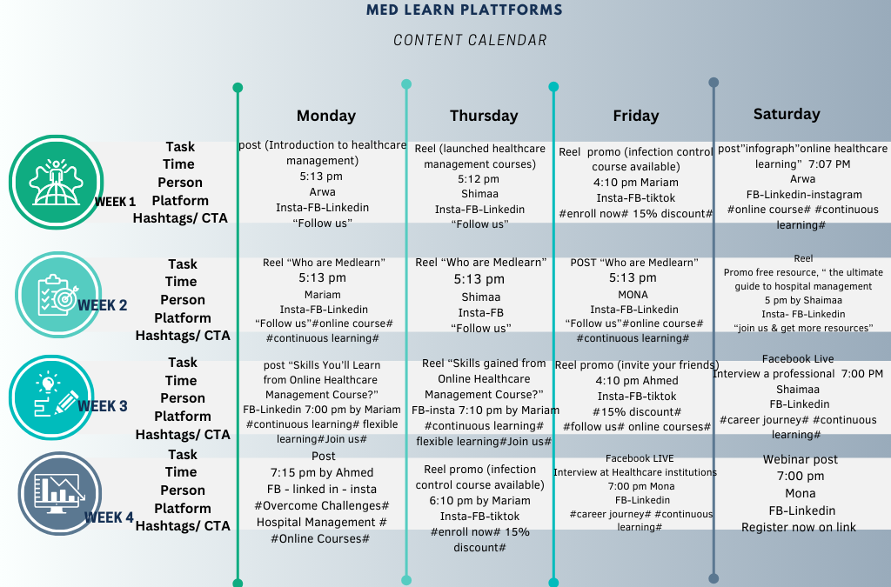

Slide 24
Action
Phase 1: Awareness and Engagement (Months 1-3)
Activity | Deadline | Responsible Party | Budget (EGP)
Social media marketing (Facebook, LinkedIn, Instagram) | Ongoing | Marketing Team | 2000/month
Content marketing (blog posts, articles, webinars) | Monthly | Content Team | 5,000/month
Email marketing campaigns | Bi-weekly | Marketing Team | 3,000/month
Partnerships with healthcare associations | Q1 | Partnerships Team | 15,000
Attend healthcare conferences and events | Q1 | Marketing Team | 10,000/event
total 55,000

Slide 25
Phase 2: Conversion and Retention (Months 4-6)
Activity | Deadline | Responsible Party | Budget (EGP)
Paid advertising (Google Ads, Facebook Ads) | Ongoing | Marketing Team | 10,000/month
Targeted email marketing campaigns | Weekly | Marketing Team | 5,000/month
User onboarding and support | Ongoing | Customer Support Team | 10,000/month
Referral program | Q2 | Marketing Team | 5,000
Customer satisfaction surveys | Bi-monthly | Marketing Team | 2,000/month
total 86,000

Slide 26
Phase 3: Growth and Expansion (Months 7-12
Activity | Deadline | Responsible Party | Budget (EGP)
Influencer marketing | Q3 | Marketing Team | 25,000
Public relations (media outreach) | Q3 | PR Team | 25,000
International expansion (e.g., neighboring Arab countries) | Q4 | Business Development Team | 25,000
Partnerships with international healthcare organizations | Q4 | Partnerships Team | 25,000
Total budget:241,000 EGP
total 100,000

Slide 27


posts on Facebook Example
We made creative content (text +image+ reels) taken into consideration our theme color .

Slide 28
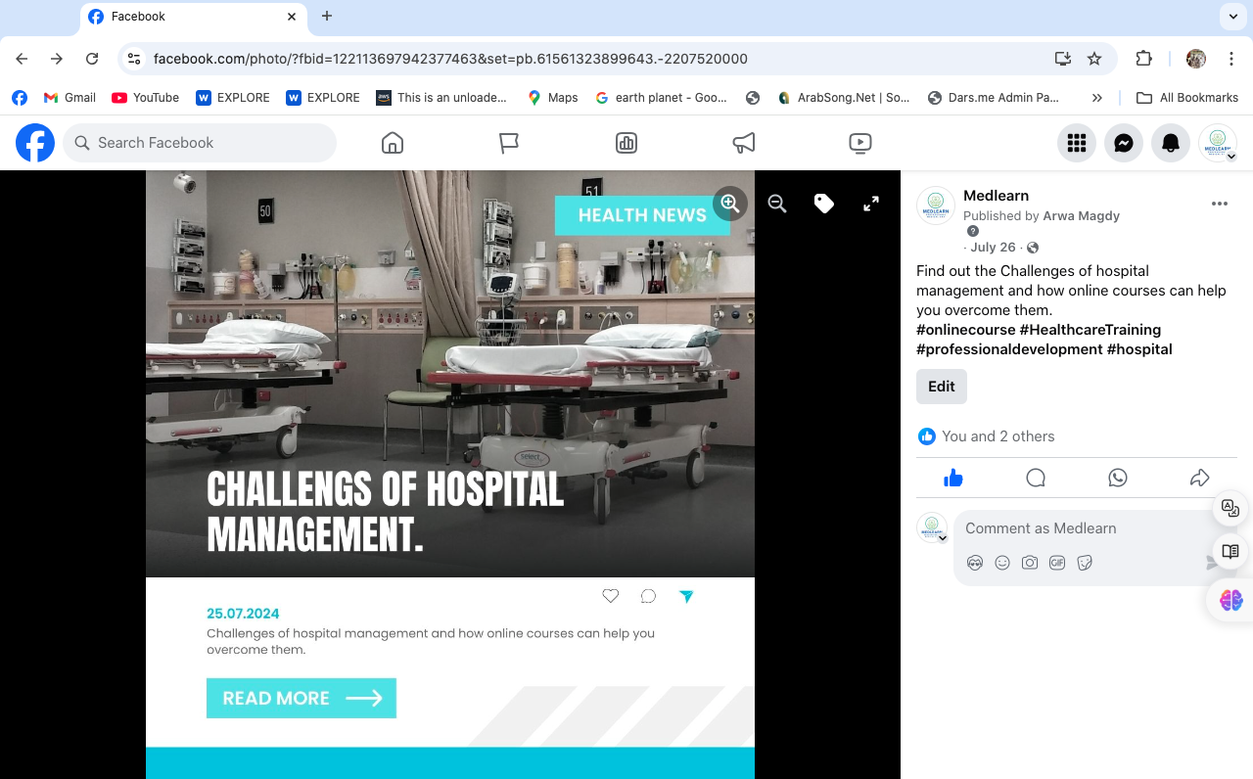
https://www.facebook.com/photo.php?fbid=122113697942377463&set=pb.61561323899643.-2207520000&type=3

Slide 29

Reel on instagram Example
https://www.instagram.com/reel/C-KeCrFSrhE/?utm_source=ig_web_copy_link

Slide 30
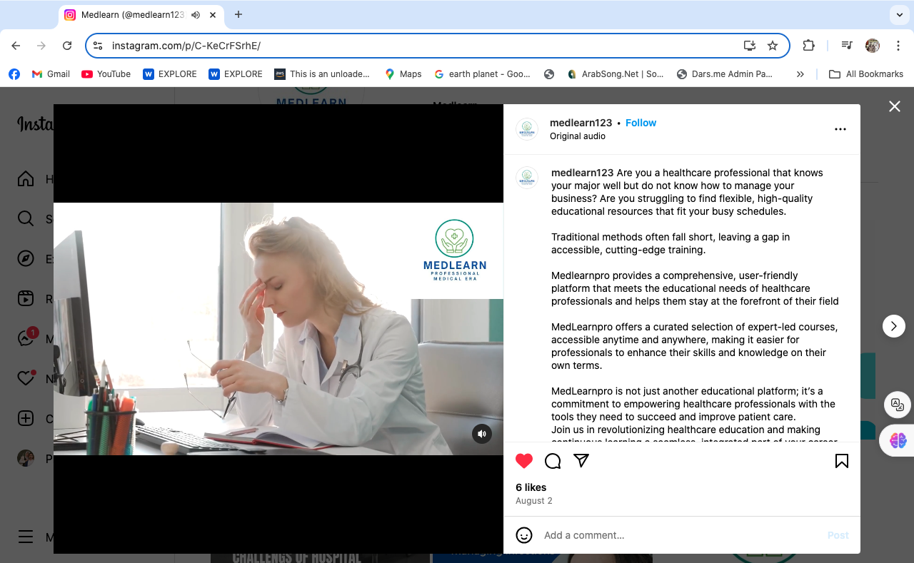

Slide 31
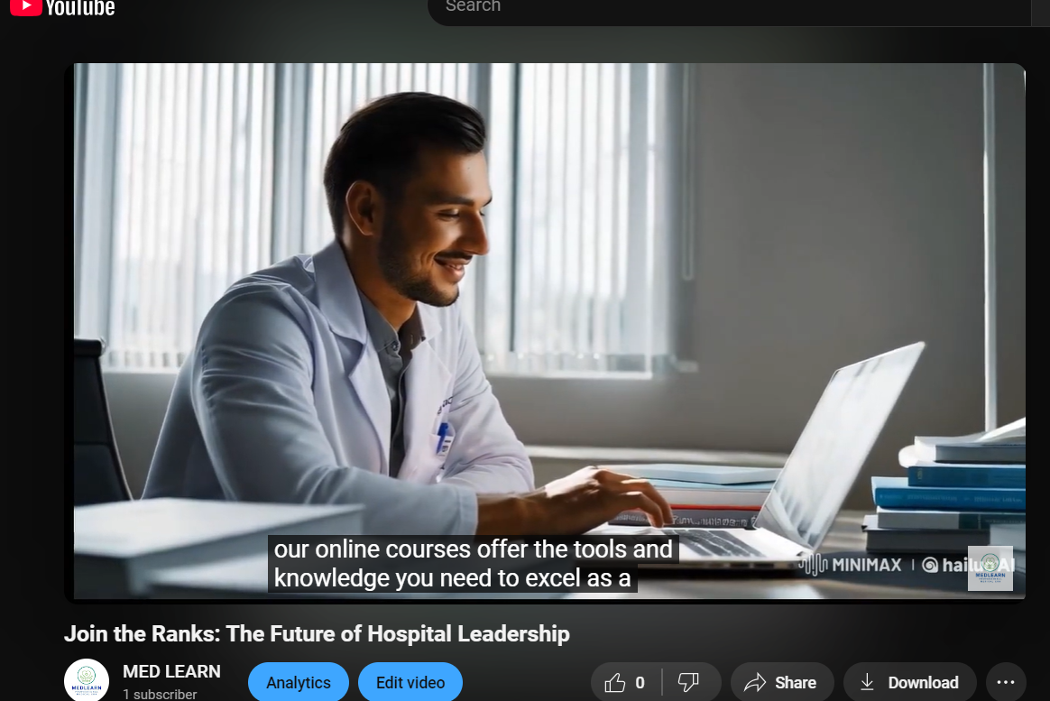
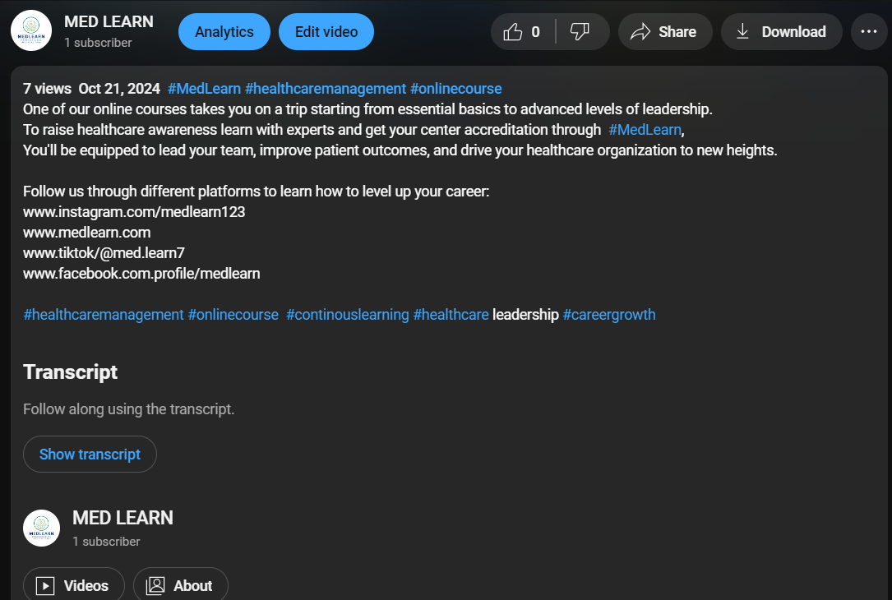
Video on Youtube Example
https://www.youtube.com/watch?v=lmcy37rXCng

Slide 32
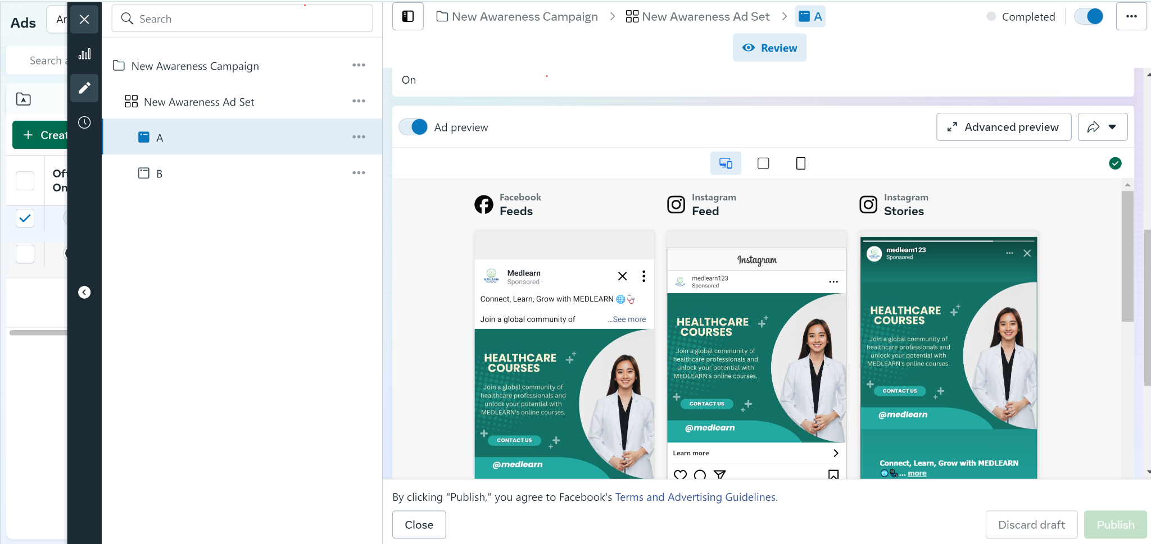
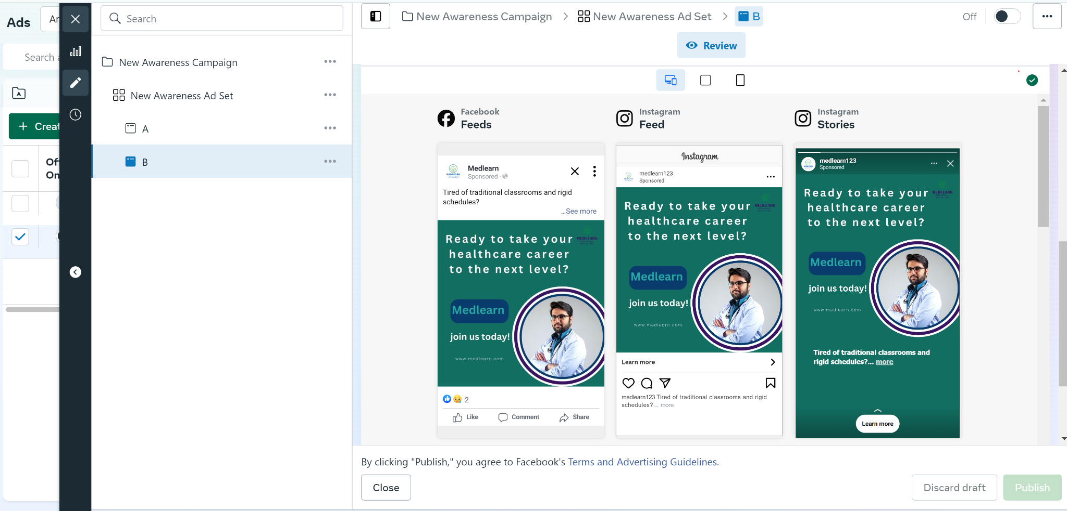
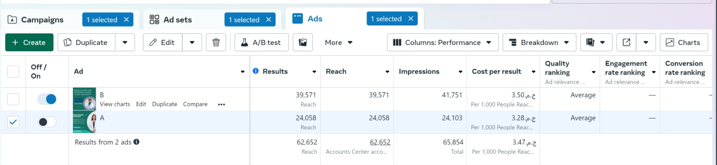
Awareness campaign paid ad
A
B
Depending on the result we continued with B

Slide 33
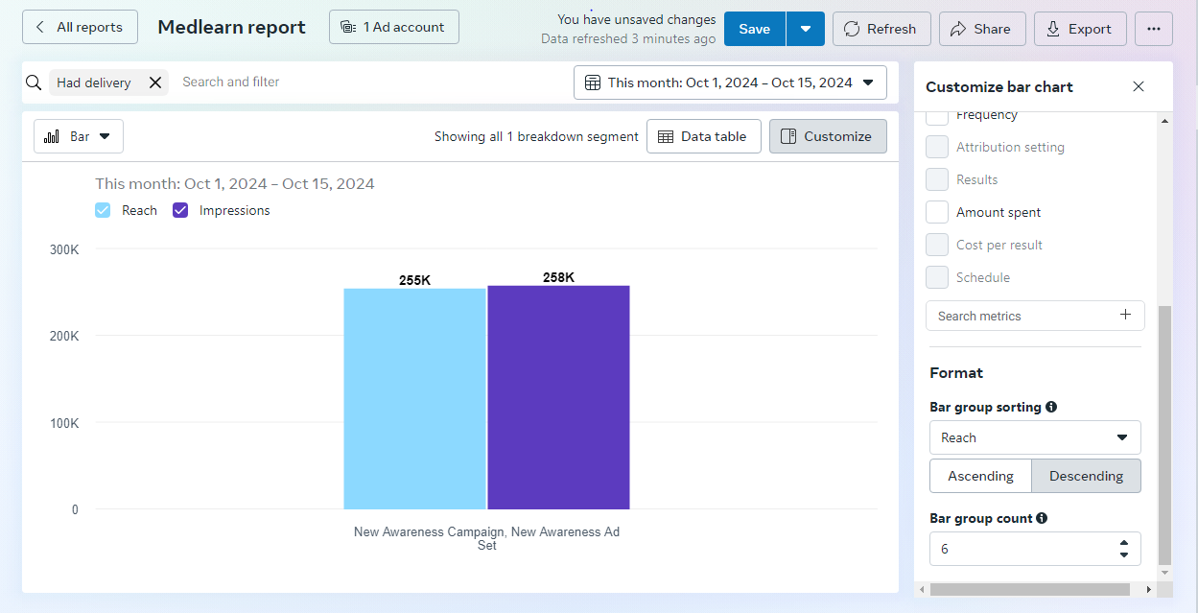
Awareness campaign result
reach and impressions

Slide 34
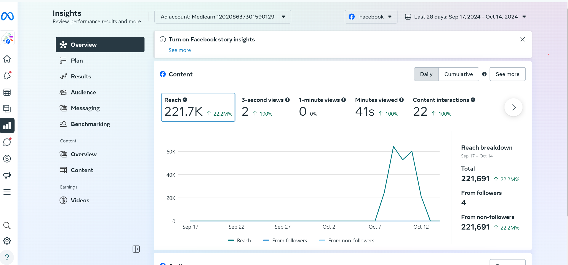
page insights
facebook

Slide 35
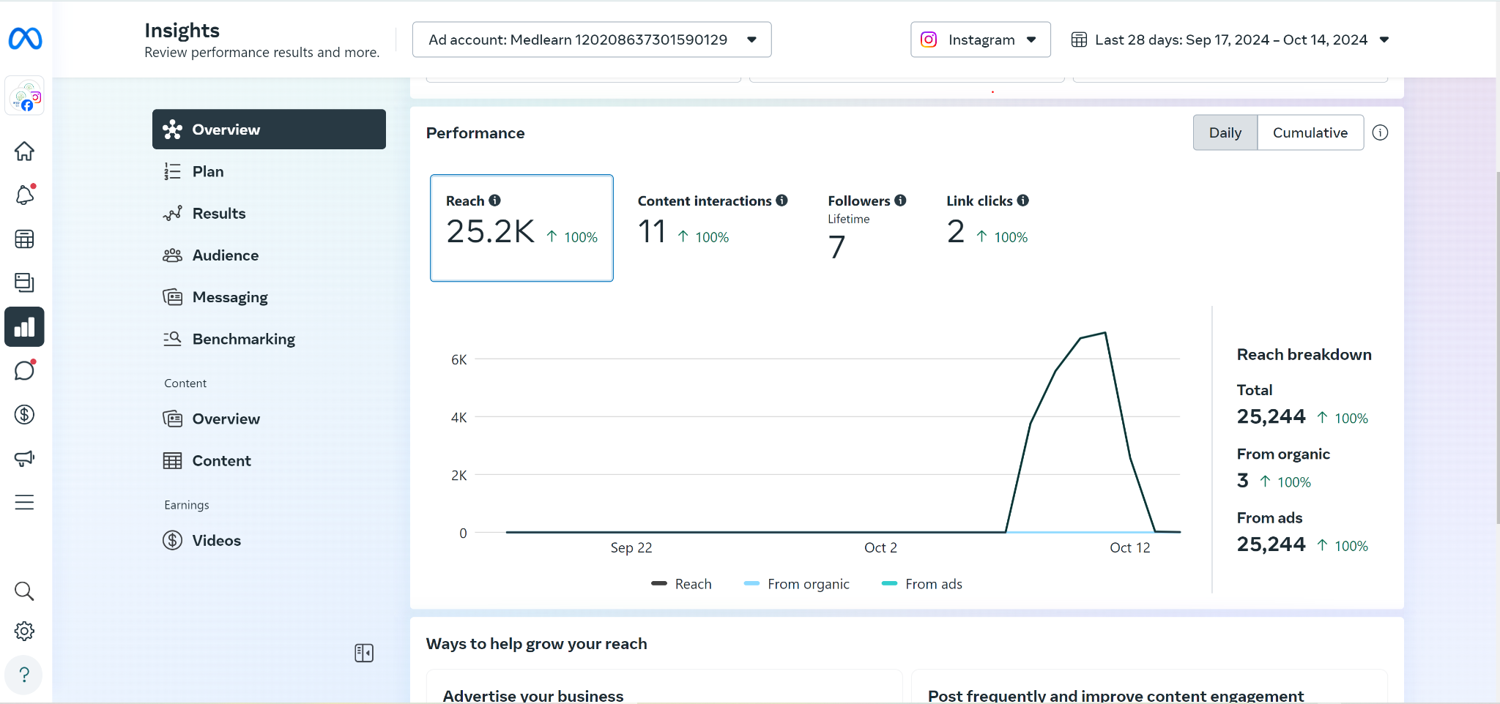
Instagram

Slide 36
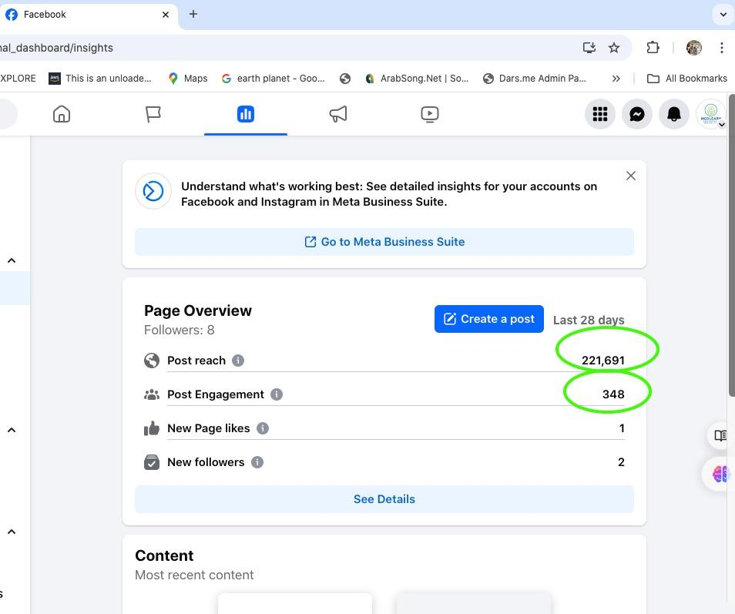

Slide 37
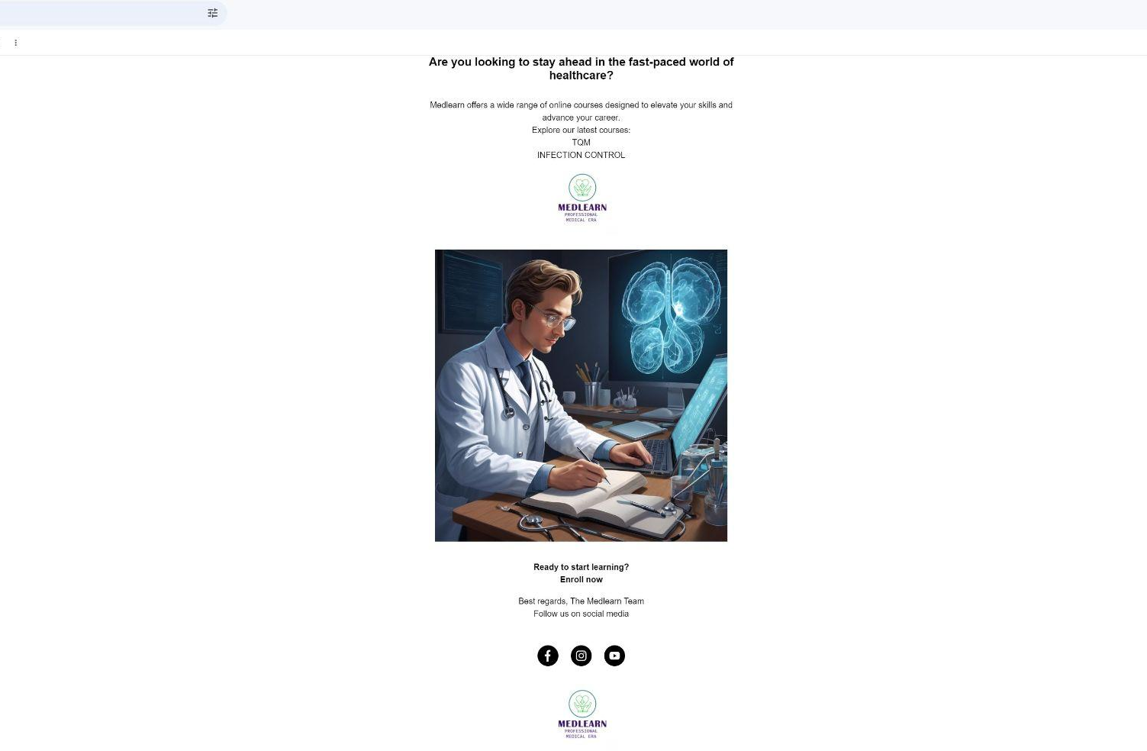
Email campaign

Slide 38
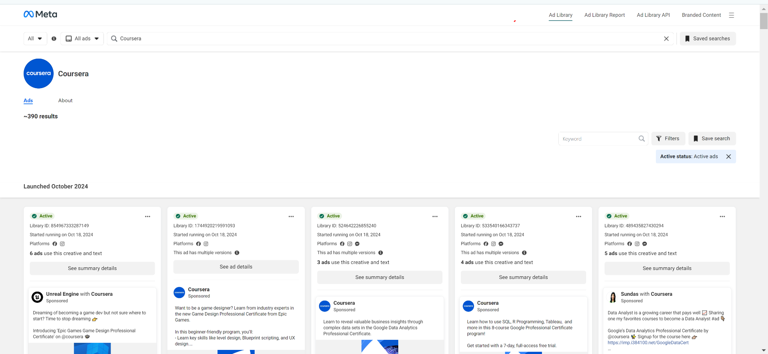
one of our competitor’s ads library

Slide 39
KPIs
Indicator | Kind/ Equation | Target | Frequency of measuring
No. of total platform subscribers | Total Number (outcome) | 1000 new subscribers 10,000 for 1st year | Monthly Annual
% of inactive Accounts | Number of inactive accounts / total no of platform subscribers *100 | < 20% | Monthly
% of subscribers completing at least one course | No. of subscribers finished 1 course/ No. of total subscribers on platform*100 | > 80 % | Weekly
LinkedIn posts reach | Number of accounts reach(views) | 7000 - 10,000 | weekly
Total no. of Facebook views | Number of accounts reach(views) | 15,000 | weekly
Total No. of reviews / Testimonials on social media | No of completed course certificates, shares, mentions of official feedback, review on social media | 500 | Annual

Slide 40
KPIs
Indicator | Kind/ Equation | Target | Frequency of measuring
Platform rating from subscribers | Average Rate from 1:5 for each course | > 4.5 | Monthly Annual
% Technical reported problem solving | Number of solved reported technical problems/ total no of subscribers’ reported technical problems *100 | > 90% | Monthly

Slide 41
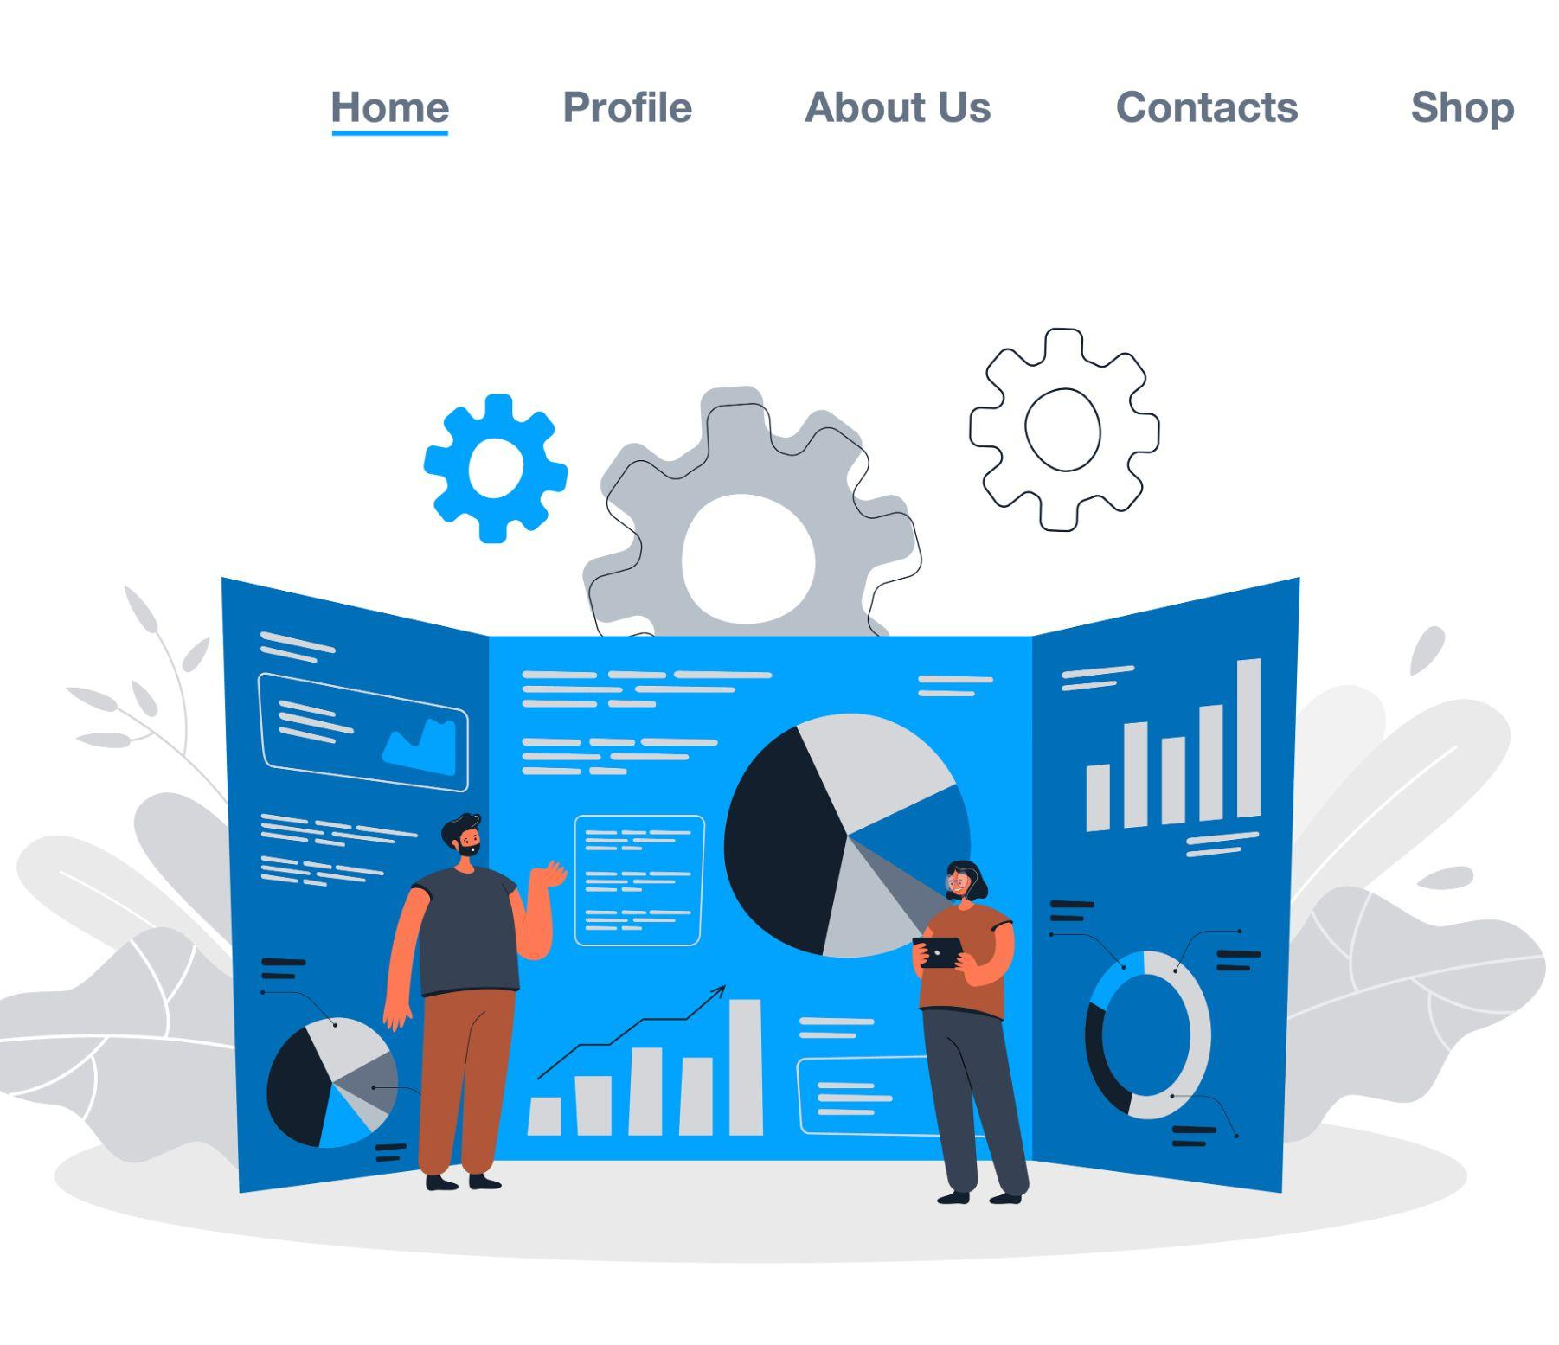
KPIs Analysis
Growing number of total platform subscribers
Successful Facebook Ads. campaign.
instagram posts reach needs further improvement.
High number of inactive accounts on platform.
poor LinkedIn posts reach.

Slide 42

Recommendations
Optimize course content (interactive elements to the platform, like quizzes, simulations, or case studies) to enhance learning engagement.
Partnership with healthcare influencers to promote Instagram content to their followers.
Invest more in LinkedIn content.
Use the same audience group for the next campaign on Facebook ads.

Slide 43
Thank YOU

